Slide 1



Welcome to our class

Slide 2



L
1
E
2
T
3
T
4
E
5
R
6

Slide 3


:
Unit 5
STUDY HABITS
PERIOD: 31
WRITE

Slide 4
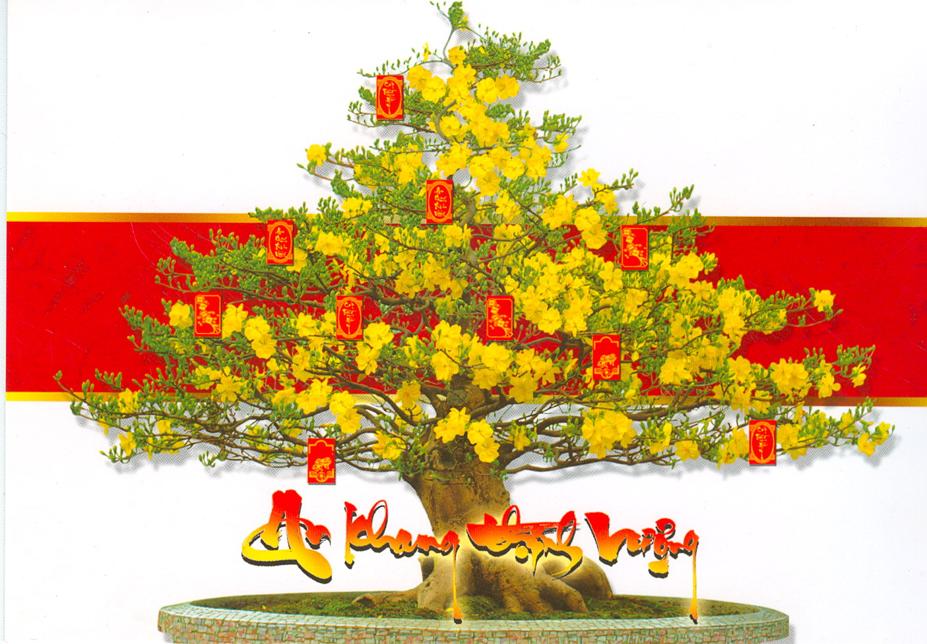
UNIT 5 STUDY HABITS
WRITE ( pages 50,51 )
I. Vocabulary:
- Lunar New Year :
UNIT 5 STUDY HABITS
WRITE ( pages 50,51 )
tết nguyên đán

Slide 5
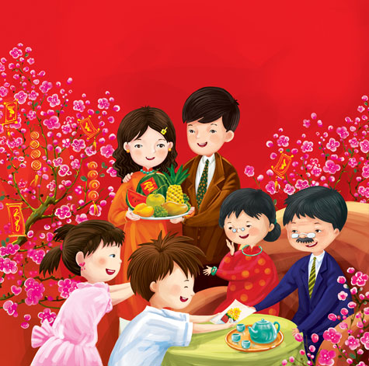
UNIT 5 STUDY HABITS
WRITE ( pages 50,51 )
I. Vocabulary:
- Lunar New Year :
enjoyable (adj):
UNIT 5 STUDY HABITS
WRITE ( pages 50,51 )
tết nguyên đán
thích thú, thú vị

Slide 6
UNIT 5 STUDY HABITS
WRITE ( pages 50,51 )
I. Vocabulary:
- Lunar New Year :
enjoyable (adj):
(to) celebrate:
UNIT 5 STUDY HABITS
WRITE ( pages 50,51 )
tết nguyên đán
thích thú, thú vị
tổ chức, làm lễ kỷ niệm

Slide 7
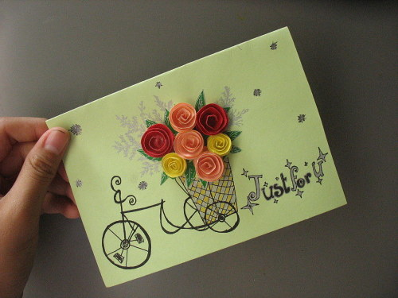
UNIT 5 STUDY HABITS
WRITE ( pages 50,51 )
I. Vocabulary:
- Lunar New Year :
enjoyable (adj):
(to) celebrate:
a postcard:
UNIT 5 STUDY HABITS
WRITE ( pages 50,51 )
tết nguyên đán
thích thú, thú vị
tổ chức, làm lễ kỷ niệm
bưu thiếp

Slide 8
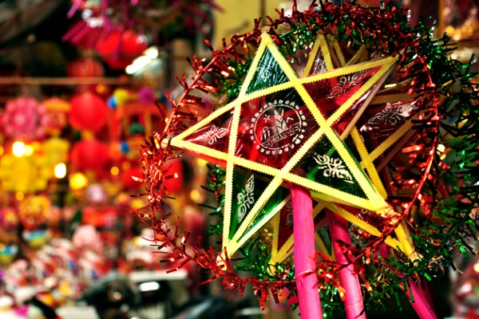
UNIT 5 STUDY HABITS
WRITE ( pages 50,51 )
I. Vocabulary:
- Lunar New Year :
enjoyable (adj):
(to) celebrate:
a postcard:
Mid Autumn Festival:
UNIT 5 STUDY HABITS
WRITE ( pages 50,51 )
tết nguyên đán
thích thú, thú vị
tổ chức, làm lễ kỷ niệm
bưu thiếp
tết trung thu

Slide 9

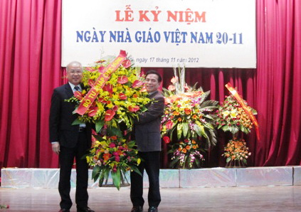
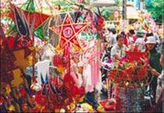
* Check:
Matching
a
b
1. (to) celebrate
2. enjoyable
3. Lunar New Year Festival
c
4. Mid- Autumn Festival
d

Slide 10
12 Tran Hung Dao St.
Writer’s address
Heading
Dear...,
Date
Opening
A letter
Feb. 10, 20.…
Closing
Body
Regards,
your friend,
Love,
Thanks for…....
(Some more information)

Slide 12
12 Tran Hung Dao St.
Ha Noi
February 10,200....
Dear Tim,
Thanks for your letter. I’m pleased to hear you had an enjoyable Christmas vacation.
We received our first semester report a few days ago. I got good grades for Science, English and History, but my math result was poor. My Math teacher asked me to spend more time on it. I must study harder next semester.
It is almost Tet. That’s the Lunar new year Festival inViet Nam. I think I told you about it in my last letter. We’re going to Hue tonight to celebrate the festival with my grandmother. I’ll send you a postcard from there.
Write soon and tell me all your news.
Regards.
Hoa.
Informal letter
1
2
Body of the letter
Heading – writer’s address and the date
Closing – Your friend / Regards / Love
Opening – Dear ..,
3
4

Slide 13
12 Tran Hung Dao St.
Ha Noi
February 10,200....
Dear Tim,
Thanks for your letter. I’m pleased to hear you had an enjoyable Christmas vacation.
We received our first semester report a few days ago. I got good grades for Science, English and History, but my math result was poor. My Math teacher asked me to spend more time on it. I must study harder next semester.
It is almost Tet. That’s the Lunar new year Festival in Viet Nam. I think I told you about it in my last letter. We’re going to Hue tonight to celebrate the festival with my grandmother. I’ll send you a postcard from there.
Write soon and tell me all your news.
Regards.
Hoa.

Slide 14
*Answer the questions about Hoa’s letter
1. Who did Hoa write the letter to?
2. What is Hoa pleased to?
3. When did Hoa receive the first semester report?
4. Which subjects was she good at?
5. Which subjects was she bad at ?
6. Which festival is she going to celebrate?
7. Where is she going to celebrate it?
8. Who is she going to celebrate with?

Slide 15

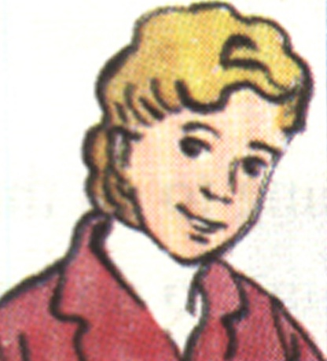
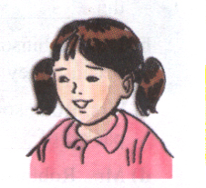
San Francisco
Donna – Lan’s penpal
Lan

Slide 16
Ex2: Write a letter to Donna, use the word cues
Mother’s Day
Second semester report / last month.
Good grades / Geography / Physics / Math.
Teacher / tell /improve English /History.
In a few weeks / Mid-Autumn Festival / moon festival.
Ha Long bay / aunt and uncle / bus / this afternoon.
Send you / postcard.

Slide 17



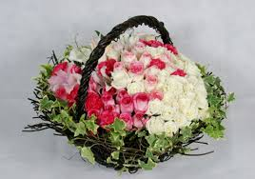

MOTHER’S DAY

Slide 18
 | HOA | LAN
wrote the letter to
pleased / glad to hear
received
good at
bad at
is going to celebrate
is going to
is going with
Cues
Tim
Donna
Tim had an enjoyable Christmas
Donna had a happy Mother’s Day
Her first semester report
Her second semester report
Science, English,
History
Geography, Physics, Math
English, History
Math
The Lunar New Year Festival
Mid-Autumn Festival
Hue
Ha Long Bay
Her grandmother
Her aunt and uncle

Slide 19
Ex2: Write a letter to Donna, use the word cues
Mother’s Day
Second semester report / last month.
Good grades / Geography / Physics / Math.
Teacher / tell /improve English /History.
In a few weeks / Mid-Autumn Festival / moon festival.
Ha Long bay / aunt and uncle / bus / this afternoon.
Send you / postcard.

Slide 20
* Suggested answer
Ninh Xuan Commune, Ninh Hoa Town,
Khanh Hoa Province, Viet Nam.
October 1 st, 2013
Dear Donna,
Thanks for your letter. I’ m glad to hear you had a happy Mother’ s Day .
I received my second semester report last month . I got good grades for Geography, Physics and Math but my English and History results were poor. My teacher told me to improve English and History . I think I will have to study harder next school year .
In a few weeks, I’m going to celebrate the Mid-Autumn Festival. That is an Autumn moon festival in Vietnam. This afternoon I’m going to Ha Long Bay with my aunt and uncle by bus . I’ll send you a postcard from there.
Write soon and tell me all your news.
Love,
Lan
…………………………….…………………………..…..
………………………………………………………
…………………………………
…………………………………………
…………………………………………………………..
………………………………………………………………………………………………
………………………………………………………..
On this day we all give the best
feelings and regards to honor our teachers.

Slide 21
Consolidation
12 Tran Hung Dao St.
Writer’s address
Heading
Opening
Dear...,
Date
A
B
A letter
Oct. 25, 2011
D
C
Closing
Body
Regards,
your friend,
Love,
Thanks for ….....
(Some more information)

Slide 22
The 30th period
UNIT 5: STUDY HABITS
Lesson 5: Write
I.Vocabulary
II. Identify the sections in the letter
  1. Heading
  2. Opening
  3. Body of the letter
  4. Closing
• Lunar New Year Festival(n.phr.)
• Mid–Autumn Festival (n.phr.)
• enjoyable (adj.)
*. Help Lan write a letter to her pen pal Donna in San Francisco
• celebrate (v)
III. Homework
• result (n)
• Rewrite the letter
• Learn by heart the vocabulary
• Review requests and advise in reported speech for language focus
• regards (n)

Slide 23

Thank you very much !

